Slide 1
PUSH DOWN AUTOMATA
By : ARCHANA
Rag No :2018MCA01
Sub:TOC
Submitted to: Dr.P.M.Kamble

Slide 2

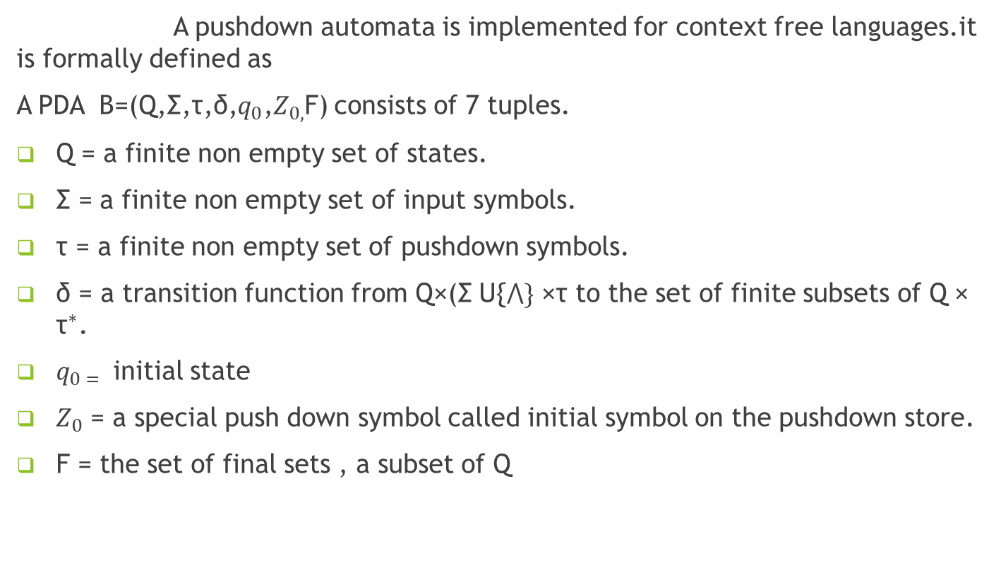
Definition
A pushdown automata is implemented for context free languages.it is formally defined as
A PDA B=(Q,Σ,τ,δ,$q_{0}$,$Z_{0,}$F) consists of 7 tuples.
Q = a finite non empty set of states.
Σ = a finite non empty set of input symbols.
τ = a finite non empty set of pushdown symbols.
δ = a transition function from Q×(Σ U{$⋀\}$ ×τ to the set of finite subsets of Q × ${\text{τ}}^{∗}$.
$q_{0 = }$initial state
$Z_{0}$ = a special push down symbol called initial symbol on the pushdown store.
F = the set of final sets , a subset of Q

Slide 3
MODEL OF PDA
 |  | a
Direction of pop
Finite state control
Z
Direction of push
Pushdown store

Slide 4

EXAMPLE
Design a PDA A=(Q,Σ,τ,δ,$q_{0,}Z_{0,}$F) which accepts input strings over a and but the input string should contain even number of a’s.
δ($q_{0}$,a, $z_{0}$)=($q_{0}$,a,$z_{0}$)
δ($q_{0}$,a , a)=($q_{0}$,$⋀$)
δ($q_{0}$,b , a)=($q_{0}$,a,)
δ($q_{0}$,b, $z_{0}$)=($q_{0}$,$z_{0}$)
δ($q_{0}$,$⋀$, $z_{0}$)=($q_{0}$,$z_{0}$)
Q={$q_{0,}q_{n}$} Σ={a , b} τ={$Z_{0}$,a} F={$q_{f}$}$≤$Q
a | b | b | a | b
Finite control
z

Slide 5
Thank you

